Slide 1
Course Introduction

Slide 2
Database Python HTML

Slide 3


User
django
Model
URL
View
Template

Slide 4

Django
Open-source web framework written in Python

Slide 5
Junior developer
Real-world scenarios
Find solutions
Utilize the framework

Slide 6
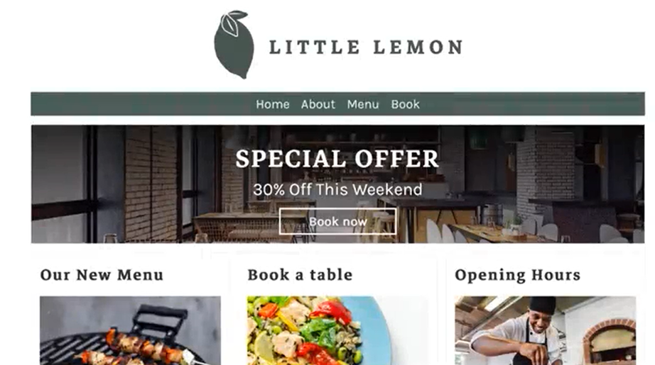

Slide 7
Storage
User access

Slide 8
User
django
Model
URL
View
Template

Slide 9
Use existing knowledge
Explore Django
Build prototype
Present

Slide 10
Introduction to Django
Views
Models
Templates
Course summary and graded assessment

Slide 11
Module 1
Differentiate between an app and project structure
Learn to use basic commands with Django-admin and manage.py
Create an app inside an existing project
Show the MVT pattern with code reusability

Slide 12
Module 2
Process basic HTTP requests
Request and , or response and HTTP
HTTP methods, URL mapping, and error handling
Class-based views

Slide 13
Module 3
Django admin panel
QuerySet API
Form API
Set up a MySQL database and apply migrations

Slide 14
Module 4
Templates and Django
template language HTML
Library integration
Debugging and testing

Slide 15
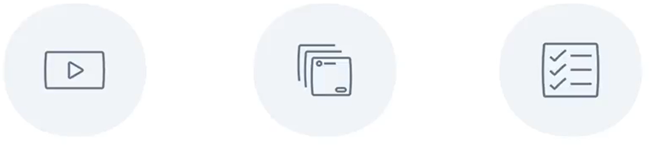


Course Material
Videos
Course readings
Exercises

Slide 16
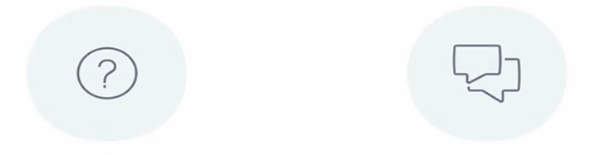
Course Material
Knowledge quizzes
Discussion prompts

Slide 17

Study schedule
Regular attendance

